Slide 1


.Net Core 5.0
Rafie Tarabay eng_rafie@mans.edu.eg

Slide 2
Main Data Types
bool x1=false;
string x2=“ALI”;
int x2=22;
object =xxxx; //Can store any data type in an object variable
DateTime dt = DateTime.Now;
Implicitly Typed
var xx=true;

Slide 3
Work with String
Define multi-line string using @
Define interpolation using $ and { }
String x=“aaaa”; String y=@”line 1 Line 2”;
Sting k=$”string x has value{x}, while string y has value{y} ”;

Slide 4
Collection
string[] strArray = {"First", "Second", "Third" }; int[] myArrayOfInts = { 0, 1, 2, 3, 4, 5, 6, 7, 8, 9 };
List<int> moreInts = new List<int>(); moreInts.Add(10);
List<Person> morePeople = new List<Person>(); //where Person is Object, check the next Slide morePeople.Add(new Person ("Frank", "Black", 50));

Slide 5
Struct And Class
Struct
Class
Structs are light versions of classes.
Structs are value types and can be used to create objects that behave like built-in types.
In structs, each variable contains its own copy of the data, and an operation on one variable does not affect another variable
Classes are reference types
Assignments of large reference types are cheaper than assignments of large value types.
In classes, two variables can contain the reference of the same object and any operation on one variable can affect another variable

Slide 6
Structures
struct Employee {
public string emp_name;
public int emp_age;
public int emp_salary;
public string emp_department;
}
Employee employee1;
employee1.emp_name = "Mike";
employee1.emp_age = 30;
employee1.emp_salary = 100000;
employee1.emp_department = "sales";
Employee employee2;
employee2.emp_name = "Jasmine";
employee2.emp_age = 23;
employee2.emp_salary = 200000;
employee2.emp_department = "marketing";

Slide 7
Class
Employee employeeOne = new Employee()
{
Id = 1,
Name = "Aiden"
};
Employee employeeTwo = new Employee()
{
Id = 2,
Name = "Jack"
};
Employee employeeThree = new Employee();
employeeThree.Id = 3;
employeeThree.Name = "Tom Clancy“;
class Employee
{
public int Id { get; set; }
public string Name { get; set; }
}

Slide 8
Stacks & Queues (using System.Collections; )
Queue (first in and first out)
Stack (last in, first out)
Queue qu = new Queue();
qu.Enqueue("Ford"); qu.Enqueue("Toyota"); st.Count(); // de-queueing items from the queue Console.WriteLine(qu.Dequeue()); Console.WriteLine(qu.Dequeue()); //Clearing a queue qu.Clear();
Stack st = new Stack(); st.Push("Toyota"); st.Push("Honda"); st.Count();
// popping elements from stack Console.WriteLine(st.Pop()); Console.WriteLine(st.Pop()); //Clearing a stack st.Clear();

Slide 9
Array, List, Ilist, IEnumerable
Array | IList | List | IEnumerable
Array is a fixed-size collection with random access (i.e. you can index into it). implement IList<> | IList is an interface which abstracts list functionality (count, add, remove, indexer access), but not a Sort(). IList inherits from IEnumerable | List supports Sort() implement IList<> List is a variable-size collection (i.e. you can add and remove elements) with random access. | Readonly, IEnumerable is an interface, is best to query data from in-memory collections, but inefficient to count elements, or to get the nth element or access by index
Keep elements order | Keep elements order | Keep elements order | IEnumerable makes no guarantees about ordering, use List or IOrderedEnumerable To keep order

Slide 10
Dictionary
Dictionary is a set of key-value pairs.
Dictionary<string, int> d = new Dictionary<string, int>();
d.Add("squash", 1);
d.Add("football", 2);
d.Add("rugby", 3);
Dictionary<string, Person> peopleA = new Dictionary<string, Person>(); peopleA.Add(“Rafie", new Person { LastName = “Tarabay", Age = 42}); Person p1 = peopleA[“Rafie"];

Slide 11
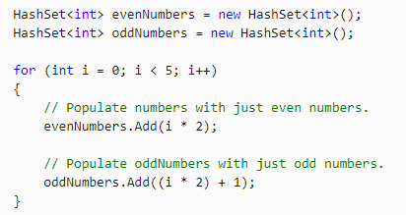
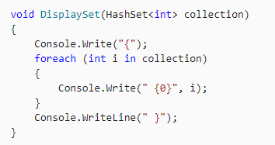
HashSet<T>
The HashSet<T> class provides high-performance set operations
A HashSet<T> collection is not sorted and cannot contain duplicate elements.
If order or element duplication is more important than performance for your application, consider using the List<T> class together with the Sort method.
HashSet operation: UnionWith, IntersectWith, ExceptWith, SymmetricExceptWith, Overlaps, IsSubsetOf, IsProperSubsetOf, IsSupersetOf, IsProperSupersetOf, SetEquals

Slide 12
HashSet vs Dictionary vs List
HashSet.Add will skip a new item if it’s deemed equal to one of the existing items and return false.
Dictionary.Add will throw an exception if the new key being added is deemed equal to one of the existing keys. However, if you use the Dictionary‘s indexer instead, it will replace the existing item if the new item is deemed equal to it.
List.Add will simply add the same item twice.
HashSet provides some very useful methods such as IsSubsetOf and Overlaps, both can be achieved on the other collection types using LINQ but HashSet provides an optimized, ready-made solution

Slide 13
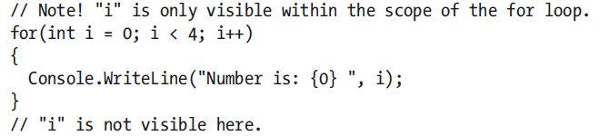
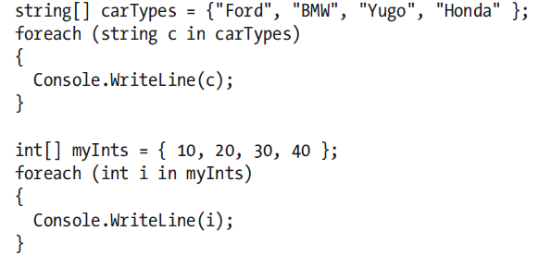
For Loop
Foreach Collection

Slide 14
Examples

Slide 15
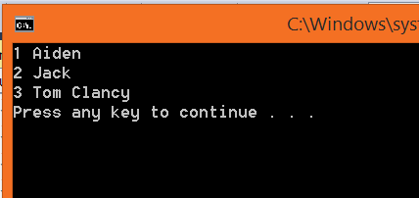
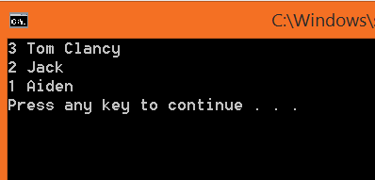
Employee employeeOne = new Employee() ; employeeOne.Id = 1; employeeOne Name = "Aiden" ;
Employee employeeTwo = new Employee(); employeeTwo.Id = 2; employeeTwo.Name = "Jack"
Employee employeeThree = new Employee() ; employeeThree .Id = 3; employeeThree .Name = "Tom Clancy“;
IList<Employee> ilist = new List<Employee>(); List<Employee> employeeList = new List<Employee>(); Queue<Employee> employeeQueue = new Queue<Employee>();
Stack<Employee> EmployeeStack = new Stack<Employee>();
ilist.Add(employeeOne);
employeeList.Add(employeeOne);
employeeQueue.Enqueue(employeeOne);
EmployeeStack.Push(employeeOne);
foreach(Employee emp in employeeQueue) {
Console.WriteLine(emp.Id + " "+emp.Name);
}

Slide 16
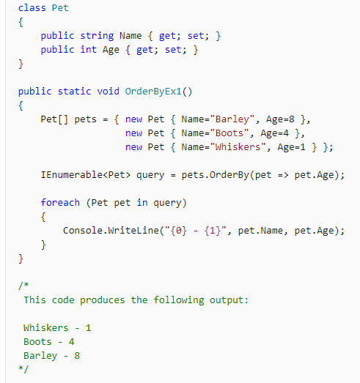
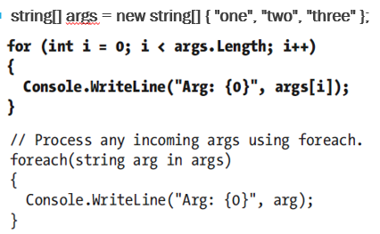
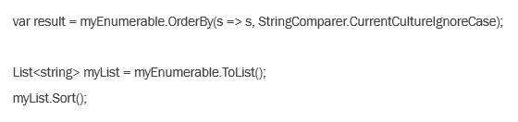

Slide 17
C# Tips

Slide 18
FAT ARROW
Fat arrow property:
public override double TotalSpecialPower => 1000;
Is equivalent to:
public override double TotalSpecialPower { get { return 1000; } }
Fat arrow method (note the parentheses):
public override double TotalSpecialPower() => 1000;
Is equivalent to:
public override double TotalSpecialPower() { return 1000; }

Slide 19
CHECK NULL ? Vs ??
string product = null; // compiler error - this is a non-nullable type
string? product = null; // no error - this is a nullable type
string relatedName = p?.Related?.Name;
? means check if null, and continue if not null other, set the value to null.
string relatedName = p?.Related?.Name ?? "<None>";
decimal? price = p?.Price ?? 0;
?? if value is null replace with new value

Slide 20
Start >net 5.0 MVC

Slide 21
MVC Project with APIs
View
Client Side HTML
Controller
Server-Side Logic
Model
Database schema as C# Classes

Slide 22
Create MVC Project without writing Code

Slide 23
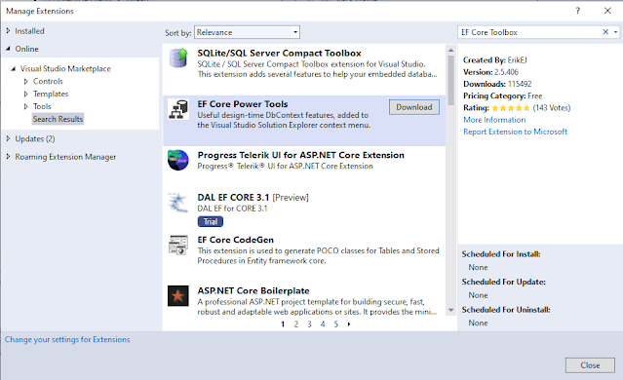
Prepare Database Tables and define relation between tables
Install "EF Core Power Tools" from Extensions

Slide 24
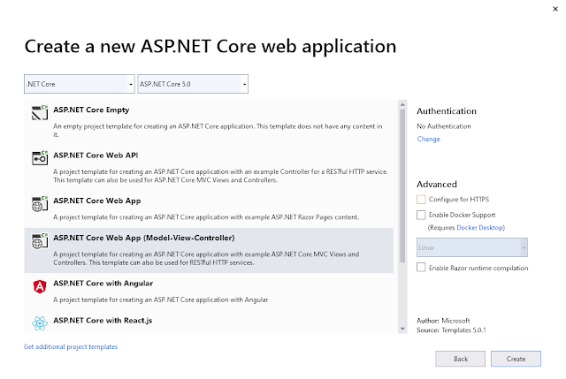
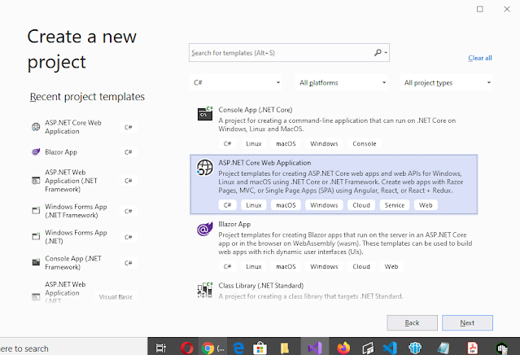
Create new MVC Project

Slide 25
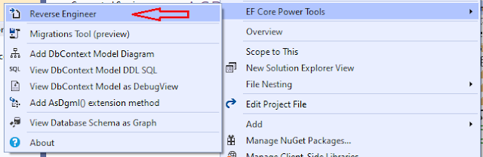
Import Database Schema
Right click on the solution and choose "EF Core Power Tools" > Reverse Engineering

Slide 26
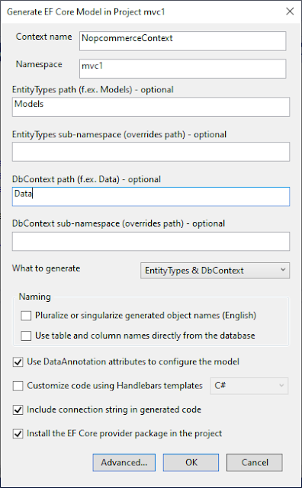
Import Database Configuration
choose DB and Tables to generate the related classes and DBContext - Set EntityTypes Path= Models - Set DBContext Path= Data - Check Data Annotation - Check Include Connection String - Check Install EF Core Packages
Notes: After create DBContext, you can use it direct like this
var _db = new NopcommerceContext(); var Lang = _db.Country.ToList();
But it is better to add it to dependency injection, using start class ConfigService method.

Slide 27
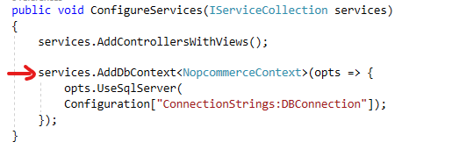
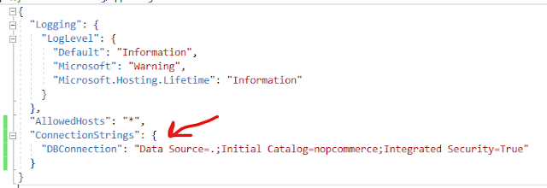
Configure DI
Open \"Startup.cs">"ConfigureServices" add "DBContext" Service
Update "appsettings.json" add "ConnectionStrings"
Notes:
services.AddDbContext<MydbContext>(opts => {
opts.UseSqlServer(
Configuration["ConnectionStrings:DBConnection"]);
});
//---------------------------------------------------
{
"Logging": {
"LogLevel": {
"Default": "Information",
"Microsoft": "Warning",
"Microsoft.Hosting.Lifetime": "Information"
}
},
"AllowedHosts": "*",
"ConnectionStrings": {
"DBConnection": "Data Source=.;Initial Catalog=ArabAuthorsIndex;Integrated Security=True",
}
}

Slide 28
Access dependency injection DI in any new class Constructor
After define DBContext in dependency injection, we can access DB using any controller like this
public class LanguagesController : Controller { private readonly NopcommerceContext _context; public LanguagesController(NopcommerceContext context) { _context = context; }
}
Notes: DEPENDENCY INJECTION is a Design Pattern used to pass object (inject object) to any class instead of define it locally in every class, this give us advantage to create a single instance of that class or even choose different implementation when user point to abstract class

Slide 29
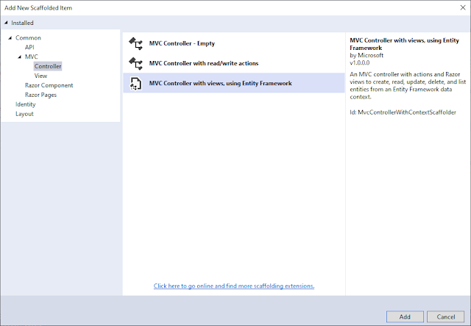
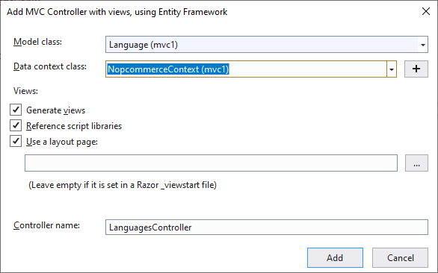
Define CURD for DB Table
Right click on "Controller" folder and choose "Add new Controller", from the new menu choose "MVC using Entity Framework“, from new screen choose class and DBContext and ControllerName then click OK

Slide 30
Update Generated code in lookups
Now you have CURD functionality on the selected tables, but you may need to apply one modification if the field is lookup In Details and Delete update field instead of view Number, it should view the Value In Create and Edit, it should view drop down

Slide 31
Review MVC Files

Slide 32
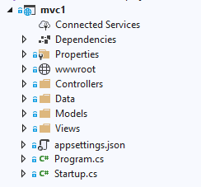
MVC Project Main Items
appsettings,.json: contains configuration options like DBconnectionString
Program.cs : start application from here and it call startup.cs
Startup.cs:
Startup() : contains reference to access appsetings.json parameters
ConfigureServices() : use for define dependance injection
Configure(): use to define supported middleware like session, static file, routing
wwwroot folder
Controllers folder
Data folder
Models folder
Views folder

Slide 33
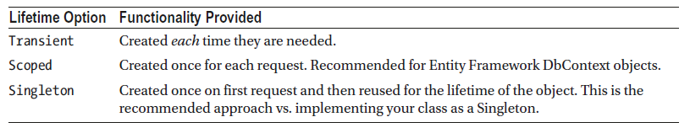
Dependency Injection
.Net Core has Built-In Dependency Injection, it is a mechanism to support loose coupling between objects. Instead of directly creating dependent objects or passing specific implementations into classes, parameters are defined as interfaces. That way, any implementation of the interface can be passed into the classes which increasing the flexibility of the application.
The ASP.NET Core DI container is typically configured in the ConfigureServices method of the Startup class using the instance of IServiceCollection that itself is injected in.
When an item is configured into the DI container, there are three lifetime options

Slide 34
Entity Framework Components

Slide 35
Building Blocks of the Entity Framework
Entities = (POCO classes) = (models): strongly typed classes that can map to Database schema (tables/Views)
DbContext Class: entities that are mapped to the database are added as DbSet<T> properties on the derived class, OnModelCreating method is used to further define the mappings between the entities and the database.
DbContextOptions: used to configure an instance of a derived DbContext class and is injected into the derived DbContext class with constructor injection
DbSet<T> Class: it is a specialized collection property used to interact with the database provider to get, add, update, or delete records in the database.

Slide 36
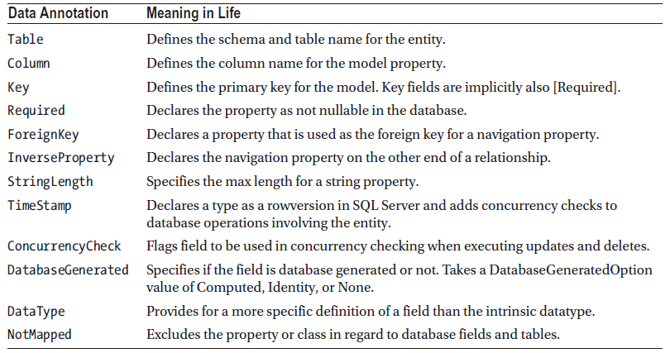
Entity Framework Data Annotations
used data annotations for defining how your entity classes and properties map to database tables and fields.

Slide 37
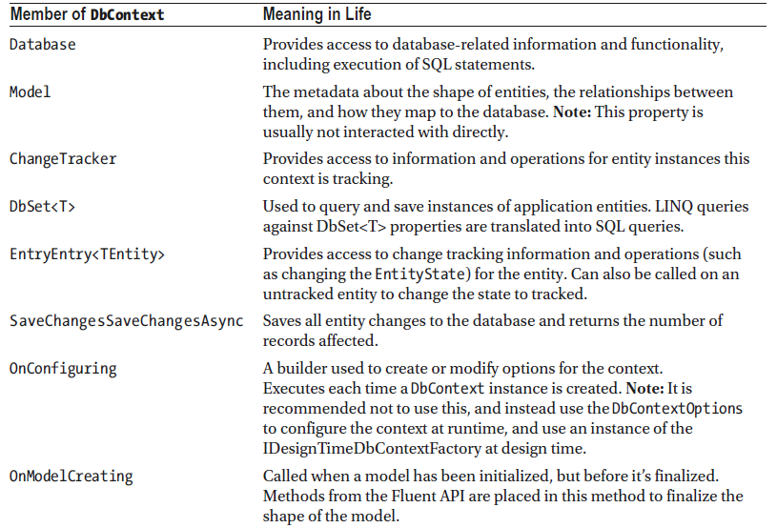

Slide 38
DbContext Select
AcademicDegrees y = await _context.AcademicDegrees.FirstOrDefaultAsync(m => m.AcademicId == 6);
var academicDegrees = await _context.AcademicDegrees.FindAsync(id);
var publications = await _context.Publications.Include(p=>p.Author).FirstOrDefaultAsync(m => m.ItemId == 4);
var User = _context.PersonBasicData.Where(x => x.PersonId == loginUser.PersonId).FirstOrDefault();
IEnumerable<AcademicDegrees> x = await _context.AcademicDegrees.ToListAsync();
var Users = _context.Person.Where(x => x.EnName.Contains(FName) || x.ArName.Contains(FName)).OrderBy(y => y.EnName).ToList();
List<MarcDictionary> marcDictionary = _context.MarcDictionary.Where(x => x.Tag.StartsWith(id) && x.TagType == "0").ToList();
IEnumerable<MyCalender> mydbContext = _context.MyCalender.Include(m => m.User).Where(e => e.UserId =33) .ToListAsync();
var mrc = await _context.MarcRecordSummary.FromSqlInterpolated($"select * from MarcRecordSummary where type={f1})").ToListAsync();
var car = Context.Cars.FromSqlInterpolated($"Select * from dbo.Inventory where Id = {carId}").Include(x=>x.MakeNavigation).First();
var customers = Context.Customers.OrderBy(x => x.Information.LastName).ThenBy(x => x.Information.FirstName).ToList();

Slide 39
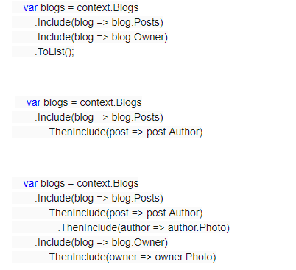
Left Join using EF (Include, and ThenInclude)

Slide 40
DbContext Delete
await _context.Database.ExecuteSqlInterpolatedAsync($"delete FROM MarcDetails where BibID={id}");
var marcHeader = await _context.MarcHeader.FindAsync(id); _context.MarcHeader.Remove(marcHeader); await _context.SaveChangesAsync();
var car = Context.Cars. First(c => c.Id == 2); Context.Cars.Remove(car); Context.SaveChanges();

Slide 41
DbContext Insert
await _context.Database.ExecuteSqlInterpolatedAsync($"SET IDENTITY_INSERT dbo.MarcHeader ON; INSERT INTO dbo.MarcHeader (id) VALUES ({BibID}); SET IDENTITY_INSERT dbo.MarcHeader OFF;");
var cars = new List<Car> { new Car {Color = "Yellow",MakeId = 1,PetName = "Herbie"}, new Car {Color = "White",MakeId = 2,PetName = "Mach 5"}, }; Context.Cars.AddRange(cars); Context.SaveChanges();
var car =Context.Cars.First(c => c.Id == 1); car.Color = "White"; Context.SaveChanges();

Slide 42
EXECUTING RAW SQL WITH ENTITY FRAMEWORK CORE 5
_context.Language.FromSqlRaw("SELECT * FROM Language");
_context.Language.FromSqlInterpolated($"SELECT * FROM Language where id={id}");
_context.Database.ExecuteSqlInterpolated($"delete from Language where id={id}");
Notes:
- FromSqlInterpolated is similar to FromSqlRaw but allows you to use string interpolation syntax.
- When executing Update/Delete it return the number of affected rows, no need to use DbSet, and use DbContext.Database.ExecuteSqlRaw

Slide 43
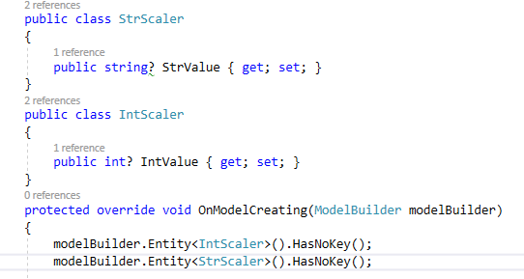
RETURN ONE SCALER VALUE FROM DATABASE USING RAW SQL
1) update context class define new class Scaler that has one column "Value" 2) update OnModelCreatingPartial and let this new class has no key
Now, set the required result as 'Value' (The same property name in the class)

Slide 44
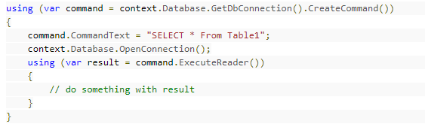
HOW TO EXECUTE GENERAL SQL USING ADO.NET

Slide 45
Sessions

Slide 46
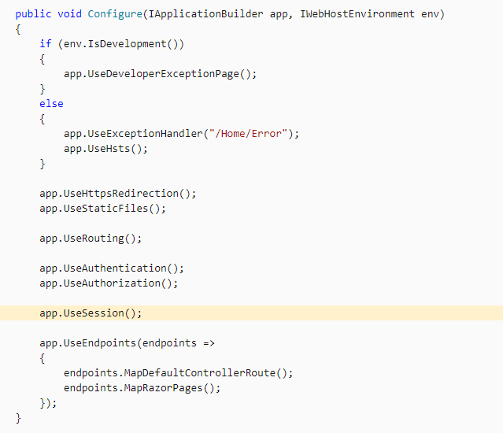
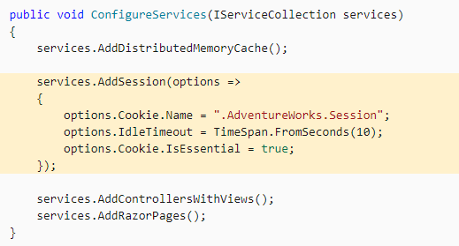
HOW TO ENABLE SESSION?
Update ConfigureServices , Configure

Slide 47
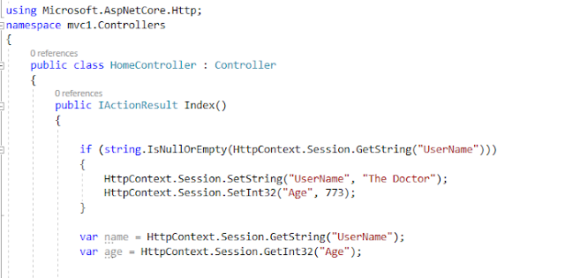
HOW TO CALL SESSION AFTER ENABLE IT?
use HttpContext.Session.SetString, and HttpContext.Session.GetString

Slide 48
Controller
In Details

Slide 49
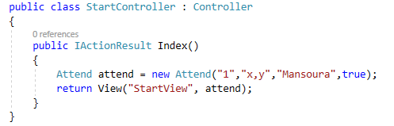
Create New Controller
Right click on controller folder and create new empty controller "StartController", which contains one default method "Index" that return "View" of type "IActionResult"
View take two parameters 1) View Name= RazorPageName 2) Data Objects to send data from controller to view

Slide 50
Controller return Value Type
By default, controller returns IActionResult which is an abstract class that can have several subtypes. IActionResult Subtypes
ViewResult - Renders a specifed view to the response stream
PartialViewResult - Renders a specifed partial view to the response stream
EmptyResult - An empty response is returned
RedirectResult - Performs an HTTP redirection to a specifed URL
RedirectToRouteResult - Performs an HTTP redirection to a URL that is determined by the routing engine, based on given route data
JsonResult - Serializes a given ViewData object to JSON format
JavaScriptResult - Returns a piece of JavaScript code that can be executed on the client
ContentResult - Writes content to the response stream without requiring a view
FileContentResult - Returns a file to the client
FileStreamResult - Returns a file to the client, which is provided by a Stream
FilePathResult - Returns a file to the client

Slide 51

HOW TO SEND DATA FROM CONTROLLER TO VIEW?
1) ViewData needs casting in the view if the value not string
2) ViewBag is strong type and does not need this casting
3) TempData can maintains its value even if you redirect the request to new page, but ViewBag,ViewData lose the values after redirect!, Note: TempData is one time use
4) ViewModel send data using View and receive it using @Model
Notes: to allow View to handle this data as HTML use @Html.Raw( ControllerValue)

Slide 52
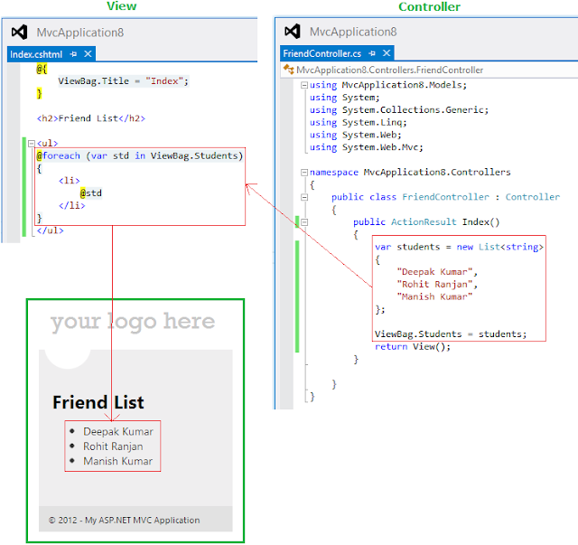
ViewBag Example

Slide 53
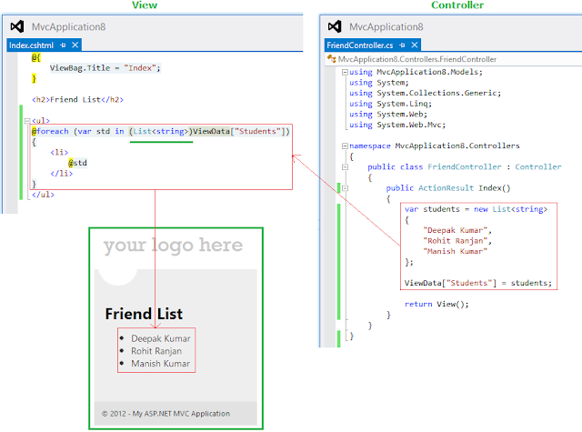
ViewData Example

Slide 54
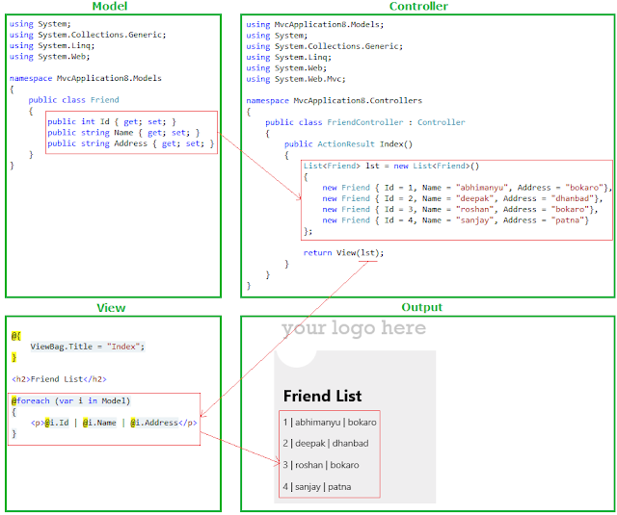
Move data using Model Example

Slide 55
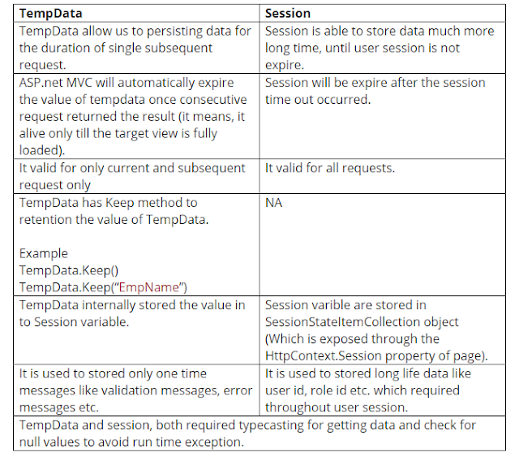
TempData vs Session

Slide 56
How to Send Dropdown menu from controller to View
In Controller
var _VacationTypeslist = _context.VacationTypes.ToList();
_VacationTypeslist.Insert(0, new VacationTypes { VacationTypeId = 0, VacationType = "Select" });
ViewBag.VacationTypeslist = new SelectList(_VacationTypeslist, "VacationTypeId", "VacationType");
In View
<select asp-for="ProjectId" asp-items="@ViewBag.VacationTypeslist" class="form-control"></select>

Slide 57
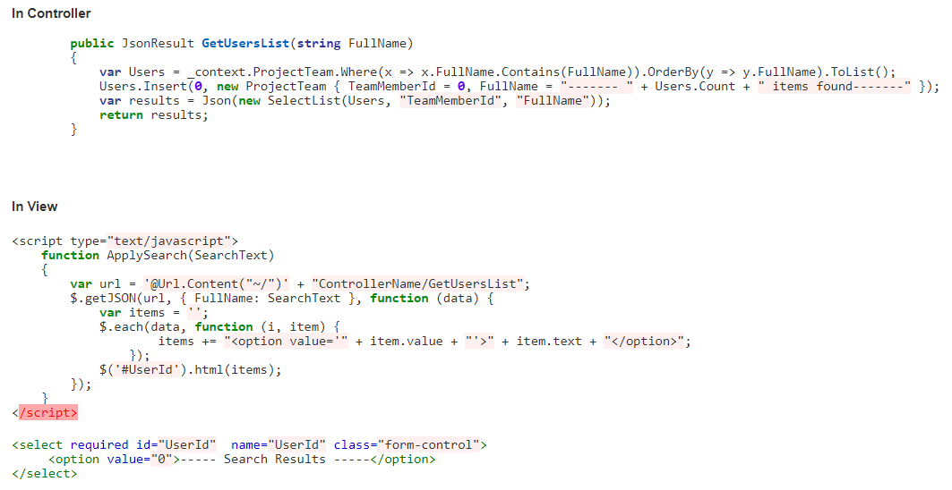
CREATE DYNAMIC DROPDOWN USING JQUERY

Slide 58
RECEIVE POSTED FORM IN CONTROLLER
[HttpPost]
public async Task<IActionResult> Create(IFormCollection collection)
{
}
Notes: IFormCollection will contains all submited fields

Slide 59
Model
In Details

Slide 60
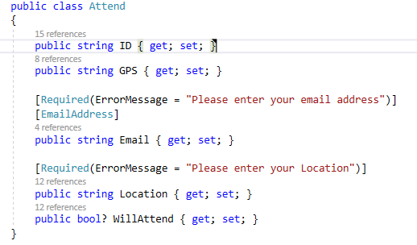
Create New Model
right click on the model folder and create new class with name attend contains 5 public properties (id,email,gps,location,willAttend)

Slide 61
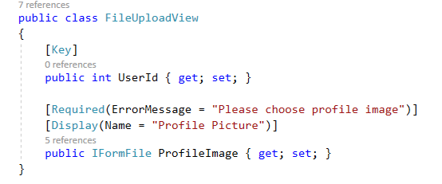
IMPORTANT MODEL ANNOTATION
// define DB column name [Column("AttendID")]
// define DB column type [DataType(DataType.Date)]

Slide 62
View
In Details

Slide 63
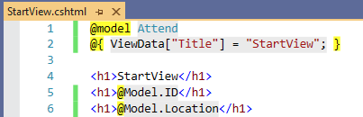
Create New View
Right click on the view folder and create new folder with name "start" contains razor page with name "StartView"

Slide 64
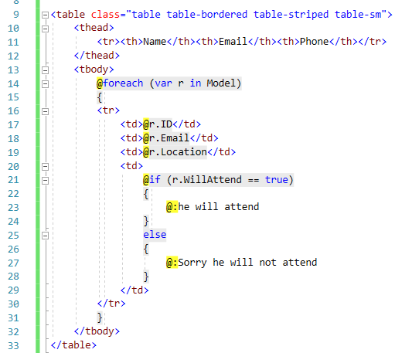
C# code in Razor Pages
Razor Pages can contain for loops and if statement like this

Slide 65
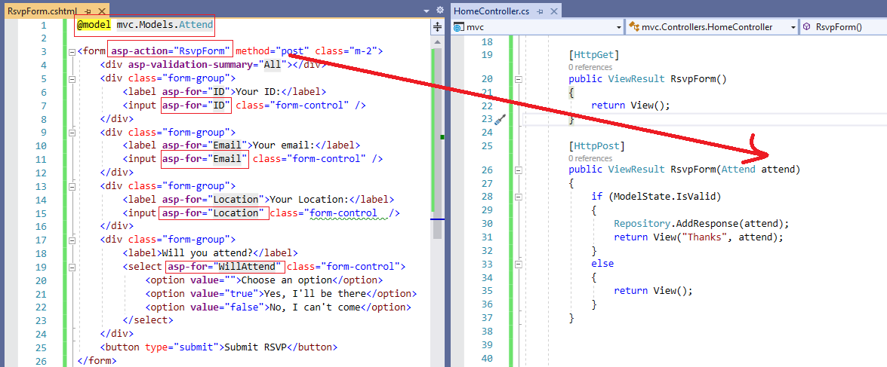
Fill View Object by Values and Send to Controller
Razor page can fill the object that you can read on controller like this

Slide 66
POST FORM TO SPECIFIC CONTROLLER
<form asp-action="ChangePassword" asp-controller="Manage" method="post">
...
</form>

Slide 67
Notes
When send data from controller to view, use @model to define the type of information we send
View can call another view by define controller and action <a asp-controller="Home" asp-action="Index">Home</a>
View can be a part of General Design template and we can set the required template using @{Layout = "_Layout";}
the default template are defined on "_ViewStart.cshtml" page
View can send data to main template using @{ ViewData["Title"] = "StartView"; }
Main Layout contains @RenderBody() to set the partial view output inside the main template

Slide 68
Shared \ _Layout.cshtml
Define Optional location
@await RenderSectionAsync("HeaderScripts", required: false)
Pass Data to optional location
@section Scripts { }
Include another HTML file
<partial name="LayoutHeader" />
Points to the main page contents, and its location inside the template
@RenderBody()

Slide 69
API
In Details

Slide 70
How to Create Web API
Right click on “Controllers” > Add > New Item > API Controllers with read/write action
API Method return object with type IActionResult or async Task<IActionResult>
Return results as a List wrap with Ok()
Other Valid Responses
BadRequest(); //Error 400
NotFound(); //Error 404
NoContent();
private readonly MyDBContext _context;
public API_InfoController(MyDBContext context)
{
_context = context;
}
// GET: api/API_Info
[HttpGet]
public IActionResult Get()
{
return Ok(_context.ProjectLocations.Include(x => x.Attendace).ToList());
}

Slide 71
